Slide 1
12-dars(oy yakuni)
Davronbek Malikov

Slide 2
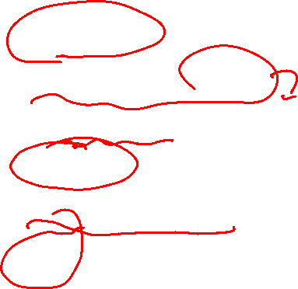

Bugun
Takrorlash
ML algorithm oilalari
ML algorithm ni qanday tanlaymiz?
Tabulate
Nimalar o’rgandik?
Final

Slide 3
Savol Javob

Slide 4
Takrorlash

Slide 5
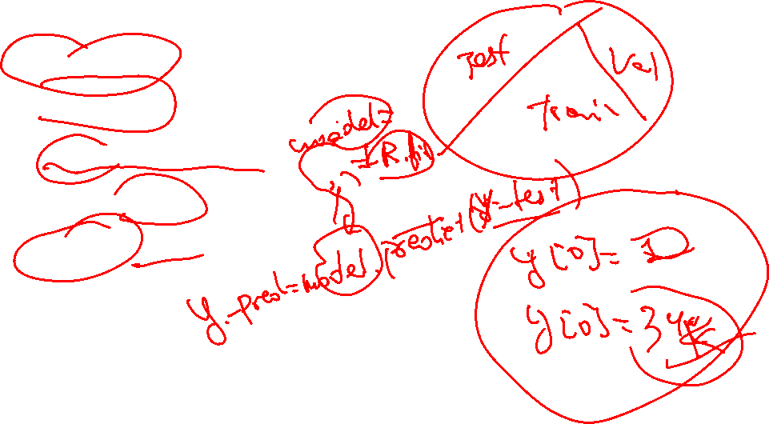
Takrorlash
Savol Javob
Takrorlash
Algorithm vs Model
Model training bosqichi
Metriklar

Slide 6
ML algorithm oilalari

Slide 7
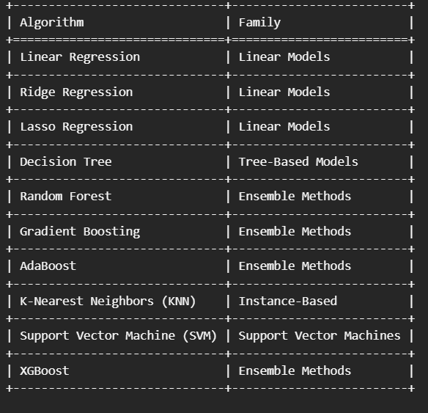
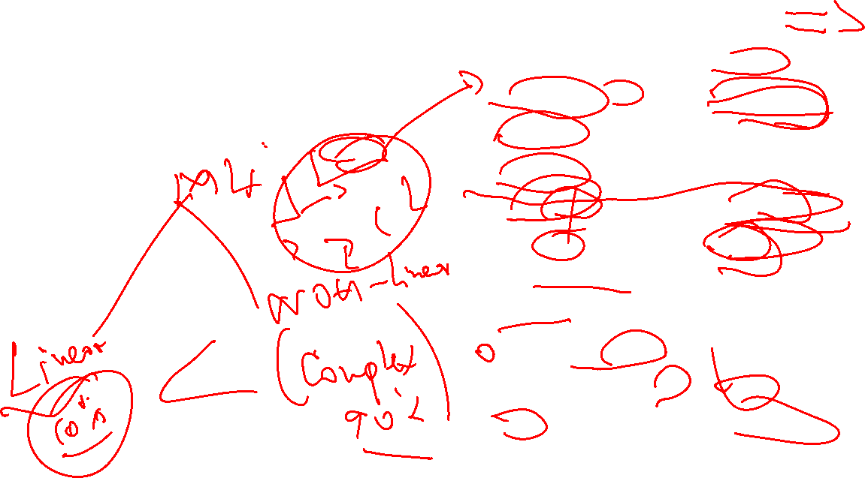
ML algorithm oilalari
Qanday qilib Algorithmlarni oson
eslab qolamiz

Slide 8
ML algorithm ni qanday tanlaymiz?

Slide 9
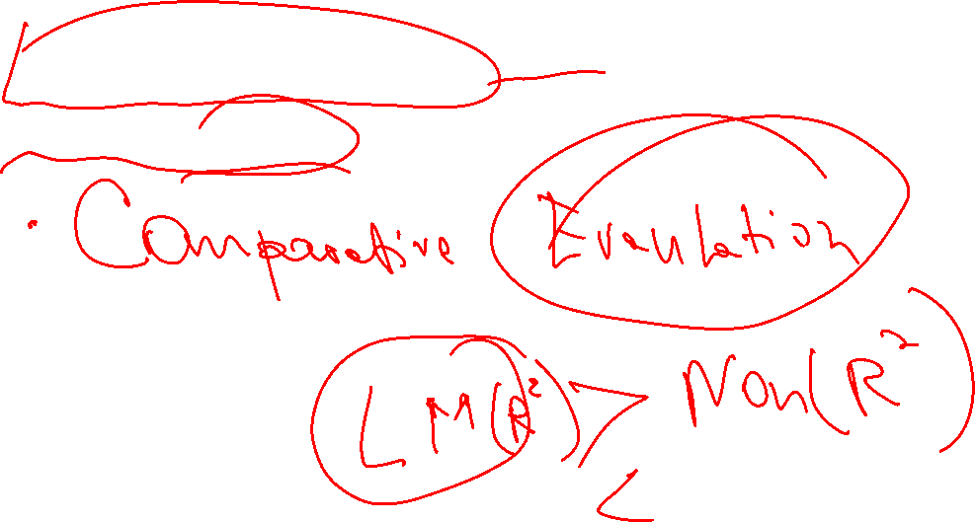
ML algorithm ni qanday tanlaymiz?
Classification // Regression
Linear // Non-Linear

Slide 10
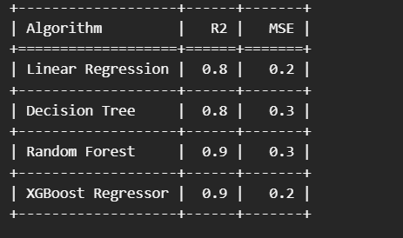

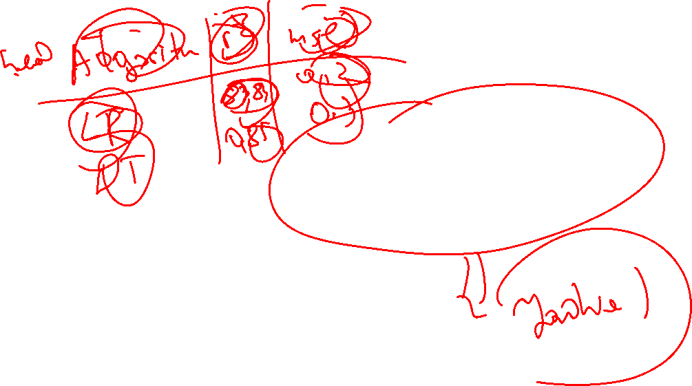

Tabulate amaliy

Slide 11
Nimalar o’rgandik?

Slide 12
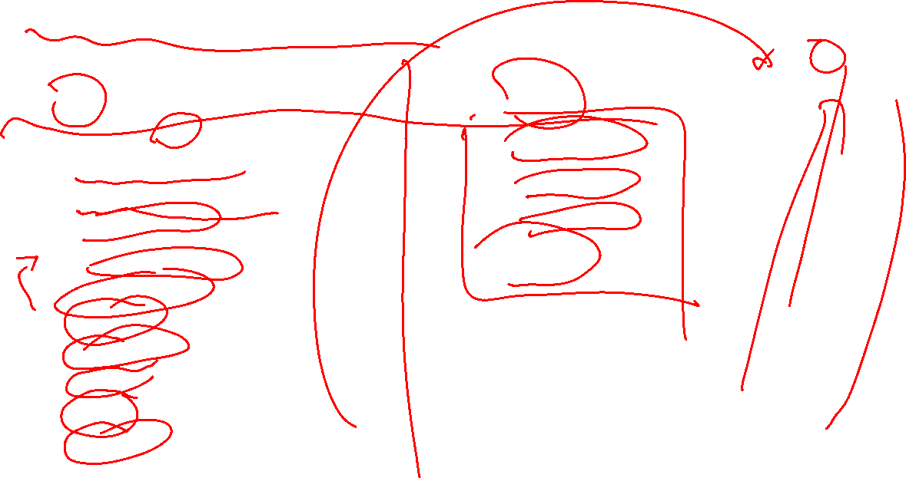
Nimalarni o’rgandik?
ML
Python
AI->ML-> SML
SML va uning turlari
Project qilish uchun ketma ketliklar
Data collection
Data Preprocessing
Model training
Predicton
Evaluation
Algorithm
Library
Project 1
Data Types
Operations
Conditions
For loop

Slide 13
Final

Slide 14

Final
Tartibi
Og’zaki
Python coding
ML coding
Ball: 50
Keyingi bosqichga o’tish uchun: 70%
Kimlar imtixon topshira oladi: Vazifani to’liq topshirganlar
Imtixon kuni:
sana:12.07.2025
soat: 08:15

